Slide 1
SC968
Panel data methods for sociologists
Lecture 3
Fixed and random effects models continued

Slide 2
Overview
Review
  Between- and within-individual variation
  Types of variables: time-invariant, time-varying and trend
  Individual heterogeneity
  Within and between estimators
The implementation of fixed and random effects models in STATA
Statistical properties of fixed and random effects models
Choosing between fixed and random effects: the Hausman test
Estimating coefficients on time-invariant variables in FE
Thinking about specification

Slide 3
Between- and within-individual variation
If you have a sample with repeated observations on the same individuals, there are two sources of variance within the sample:
  The fact that individuals are systematically different from one another (between-individual variation)
    Joe lives in Colchester, Jane lives in Wivenhoe
  The fact that individuals’ behaviour varies between observations (within-individual variation)
    Joe moves from Colchester to Wivenhoe

Slide 4
How to think about two sources of variation in panel data...
Between variation
How does an individual vary, on average, from the sample mean?
Within variation
How does an individual vary at any particular time point from his individual mean?
 | W1 | W2 | W3 | W4 | W5 | Person Mean
Jane | 20 | 20 | 20 | 20 | 20 | 20
Joe | 15 | 5 | 6 | 20 | 4 | 10
Average income for sample: £10 per year

Slide 5
xtsum in STATA
Similar to ordinary “sum” command

Slide 6
xtsum in STATA
Similar to ordinary “sum” command
Have chosen a balanced sample
All variation is “between”
Most variation is “between”, because it’s fairly rare to switch between having and not having a partner
All variation is within, because this is a balanced sample

Slide 7
More on xtsum….
Observations with non-missing variable
Number of individuals
Average number of time-points
Min & max refer to x_{i}-bar
Min & max refer to individual deviation from own averages, with global averages added back in.

Slide 8
Types of variable
Those which vary between individuals but hardly ever over time
  Sex
  Ethnicity
  Parents’ social class when you were 14
  The type of primary school you attended (once you’ve become an adult)
Those which vary over time, but not between individuals
  The retail price index
  National unemployment rates
  Age, in a cohort study
Those which vary both over time and between individuals
  Income
  Health
  Psychological wellbeing
  Number of children you have
  Marital status
Trend variables
  Vary between individuals and over time, but in highly predictable ways:
  Age
  Year

Slide 9
Within and between estimators
Individual-specific, fixed over time
Varies over time, usual assumptions apply (mean zero, homoscedastic, uncorrelated with x or u or itself)
This is the “between” estimator
And this is the “within” estimator – “fixed effects”
θ measures the weight given to between-group variation, and is derived from the variances of u_{i} and ε_{i}

Slide 10
Individual heterogeneity: one reason to used fixed effects
A very simple concept: people are different!
In social science, when we talk about heterogeneity, we are really talking about unobservable (or unobserved) heterogeneity.
  Observed heterogeneity: differences in education levels, or parental background, or anything else that we can measure and control for in regressions
  Unobserved heterogeneity: anything which is fundamentally unmeasurable, or which is rather poorly measured, or which does not happen to be measured in the particular data set we are using.
Time invariant heterogeneity
  Height (among adults)
  Innate intelligence
  Antenatal care of mother
Time variant kinds of heterogeneity
  Social network size
  Beauty
  Weight

Slide 11
Unobserved heterogeneity
Extend the OLS equation we used in Week 1, breaking the error term down into two components: one representing the time invariant, unobservable characteristics of the person, and the other representing genuine “error”.
In cross-sectional analysis, there is no way of distinguishing between the two.
But in panel data analysis, we have repeated observations – and this allows us to distinguish between them.

Slide 12
Fixed effects (within estimator)
Allows us to “net out” time-invariant unobserved characteristics
Ignores between-group variation – so it’s an inefficient estimator
However, few assumptions are required, so FE is generally consistent and unbiased
Disadvantage: can’t estimate the effects of any time-invariant variables
Also called least squares dummy variable model (LDV)
Analysis of covariance (CV) model

Slide 13
Between estimator
Not much used
  Except to calculate the θ parameter for random effects, but STATA does this, not you!
It’s inefficient compared to random effects
  It doesn’t use as much information as is available in the data (only uses means)
Assumption required: that u_{i} is uncorrelated with x_{i}
  Easy to see why: if they were correlated, how could one decide how much of the variation in y to attribute to the x’s (via the betas) as opposed to the correlation?
Can’t estimate effects of variables where mean is invariant over individuals
  Age in a cohort study
  Macro-level variables

Slide 14
Random effects estimator
Weighted average of within and between models
Assumption required: that u_{i} is uncorrelated with x_{i}
Rather heroic assumption – think of examples
Will see a test for this later
Uses both within- and between-group variation, so makes best use of the data and is efficient
But unless the assumption holds that u_{i} is uncorrelated with x_{i} , it is inconsistent
AKA one-way error components model, variance component model, GLS estimator (STATA also allows ML random effects)

Slide 15
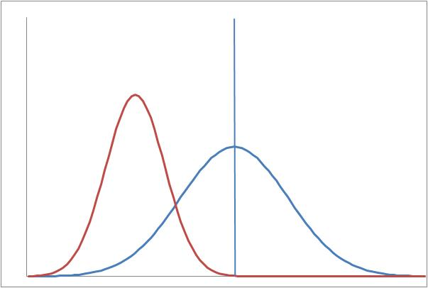
Consistency versus efficiency.
Random effects clearly does worse here…..
“True” value of betas
Inconsistent but efficient
Consistent but inefficient

Slide 16
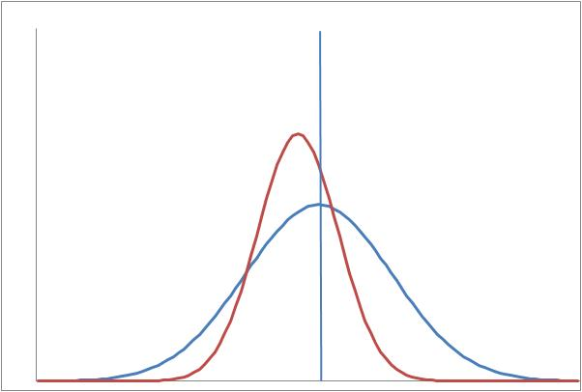
…. But arguably, random effects do a better job of getting close to the “true” coefficient here.
“True” value of betas
Random effects
Fixed effects

Slide 17
Testing between FE and RE
Hausman test
Hypothesis H₀: u_{i} is uncorrelated with x_{i}
Hypothesis H₁: u_{i} is correlated with x_{i}
Fixed effects is consistent under both H₀ and H₁
Random effects is efficient, and consistent under H₀ (but inconsistent under H₁)
Sex does not appear
Example from last week
Random effects rejected (inconsistent)
in favour of fixed effects (consistent but inefficient)

Slide 18
HOWEVER
Big disciplinary divide
Economists swear by the Hausman test and rarely report random effects
Other disciplines (eg psychology) consider other factors such as explanatory power.

Slide 19
Estimating FE in STATA
“R-square-like” statistic
Peaks at age 48
“u” and “e” are the two parts
of the error term

Slide 20
Between regression:
Not much used, but useful to compare coefficients with fixed effects
Coefficient on “partner” was negative and significant in FE model.
In FE, the “partner” coeff really measures the events of gaining or losing a partner

Slide 21
Random effects regression
Option “theta” gives a summary
of weights

Slide 22
And what about OLS?
OLS simply treats within- and between-group variation as the same
Pools data across waves

Slide 23
Comparing models
Compare coefficients between models
Reasonably similar – differences in “partner” and “badhealth” coeffs
R-squareds are similar
Within and between estimators maximise within and between r-2 respectively.

Slide 24
Test whether pooling data is valid
If the u_{i} do not vary between individuals, they can be treated as part of α and OLS is fine.
Breusch-Pagan Lagrange multiplier test
H₀ Variance of u_{i} = 0
H₁ Variance of u_{i} not equal to zero
If H₀ is not rejected, you can pool the data and use OLS
Post-estimation test after random effects

Slide 25
Thinking about the within and between estimators…..
Both between and FE models written with the same coefficient vector β, but no reason why they should be the same.
Between: β_{j} measures the difference in y associated with a one-unit difference in the average value of variable x_{j} between individuals – essentially a cross-sectional concept
Within: β_{j} measures the difference associated with a one-unit increase in variable x_{j} at individual level – essentially a longitudinal concept
Random effects, as a weighted average of the two, constrains both βs to be the same.
Excellent article at http://www.stata.com/support/faqs/stat/xt.html
And lots more at http://www.stata.com/support/faqs/stat/#models

Slide 26
Examples
Example 1:
Consider estimating a wage equation, and including a set of regional dummies, with S-E the omitted group.
Wages in (eg) the N-W are lower, so the estimated between coefficient on N-W will be negative.
However, in the within regression, we observe the effects of people moving to the N-W. Presumably they wouldn’t move without a reasonable incentive. So, the estimated within coefficient may even be positive – or at least, it’s likely to be a lot less negative.
Example 2:
Estimate the relationship between family income and children’s educational outcomes
The between-group estimates measure how well the children of richer families do, relative to the children of poorer families – we know this estimate is likely to be large and significant.
The within-group estimates measure how children’s outcomes change as their own family’s income changes. This coefficient may well be much smaller.

Slide 27
FE and time-invariant variables
Reformulating the regression equation to distinguish between time-varying and time-invariant variables:
Residual
Time-varying variables: income, health
Time-invariant variables – eg sex, race
Individual-specific fixed effect
Inconveniently, fixed effects washes out the z’s, so does not produce estimates of γ.
But there is a way!
Requires the z variable to be uncorrelated with u’s

Slide 28
Coefficients on time-invariant variables
Run FE in the normal way
Use estimates to predict the residuals
Use the between estimator to regress the residuals on the time-invariant variables
Done!
Only use this if RE is rejected: otherwise, RE provides best estimates of all coefficients
Going back to the previous example,

Slide 29
From previous slide…
Our estimate of 1.60 for the coefficient on “female” is slightly higher than, but definitely in the same ball-park as, those produced by the other methods.

Slide 30
Improving specification
Recall our problem with the “partner” coefficient
OLS and between estimates show no significant relationship between partnership status and LIKERT scores
FE and RE show a significant negative relationship.
FE estimates coefficient on deviation from mean – likely to reflect moving in together (which makes you temporarily happy) and splitting up (which makes you temporarily sad).
Investigate this by including variables to capture these events

Slide 31
Generate variables reflecting changes
Note: we will lose some observations

Slide 32
Fixed effects
Coeff on having a partner now slightly positive; getting a partner is insignificant; losing a partner is now large and positive

Slide 33
Random effects
similar
Proportion of total residual variance attributable to the u’s - c.f. random slopes models later

Slide 34
Collating the coefficients:

Slide 35
Hausman test again
Have we cleaned up the specification sufficiently that the Hausman test will now fail to reject random effects?
No! Although the chi-squared statistic is smaller now (at 116.04), than previously (at 123.96)

Slide 36
Thinking about time
Under FE, including “wave” or “year” as a continuous variable is not very useful, since it is treated as the deviation from the individual’s mean.
We may not want to treat time as a linear trend (for example, if we are looking for a cut point related to social policy)
Also, wave is very much correlated with individuals’ ages
Can do FE or RE including time periods as dummies
May be referred to as “two-way fixed effects”
Generate each dummy variable separately, or….
      local i = 1
      while `i' <= 15 {
      gen byte W`i' = (wave == `i')
      local i = `i' + 1
      }

Slide 37
Time variables insignificant here (as we would expect)

Slide 38
Extending panel data models to discrete dependent variables
Panel data extensions to logit and probit models
Recap from Week 1:
These models cover discrete (categorical) outcomes, eg psychological morbidity; whether one has a job;. Think of other examples.
Outcome variable is always 0 or 1. Estimate:
OLS (linear probability model) would set F(X,β) = X’β + ε
Inappropriate because:
  Heteroscedasticity: the outcome variable is always 0 or 1,
  so ε only takes the value -x’β or 1-x’β
  More seriously, one cannot constrain estimated probabilities
  to lie between 0 and 1.

Slide 39
Extension of logit and probit to panel data:
We won’t do the maths!
But essentially, STATA maximises a likelihood function derived from the panel data specification
Both random effects and fixed effects
First, generate the categorical variable indicating psychological morbidity
.
    gen byte PM = (hlghq2 > 2) if hlghq2 >= 0 & hlghq2 != .

Slide 40
Fixed effects estimates – xtlogit (clogit)
Is losing a partner necessarily causing the psychological morbidity?
Losing a partner, being unemployed or sick, and being in bad health are associated with psychological morbidity
Negative in age throughout the human life span

Slide 41
Adding some more variables:
We know that women sometimes suffer from post-natal depression. Try total number of children, and children aged 0-2
Total number of children is insignificant, but children 0-2 is significant.
Next step???

Slide 42
Yes, we should separate men and women
sort female
by female: xtlogit PM partner get_pnr lose_pnr female ue_sick age age2 badh nch02, fe
Men
Women
Relationship between PM and young children is confined to women
Any other gender differences?

Slide 43
Back to random effects
Estimates are VERY similar to FE

Slide 44
Testing between FE and RE
quietly xtlogit PM partner get_pnr lose_pnr female ue_sick age age2 badh nch02, fe
estimates store fixed
quietly xtlogit PM partner get_pnr lose_pnr female ue_sick age age2 badh nch02, re
hausman fixed .
Random effects is rejected again.

Slide 45
Random effects probit
No fixed effects command available, as there does not exist a sufficient statistic allowing the fixed effects to be conditioned out of the likelihood.

Slide 46
Why aren’t the sets of coefficients more similar?
Remember the conversion scale from Week 1…

